Slide 1
Pre Medical School
Mrs Neringa Smalstiene
Dr Dean Eggitt

Slide 2
Module 2 - Cardiovascular
Emergencies
Toilets
Toilets are situated
Fire Safety
No fire drill is expected
The fire alarm is a continuous bell
The fire exit is situated
Safeguarding
Concerns should be reported to Mrs Neringa or Dr Dean
Please notify us immediately if you have symptoms of Covid-19

Slide 3
Module 2 - Cardiovascular
Scenario
63 year old woman enters AE department complaining of severe chest pain…
AE Triage Nurse - “She doesn’t look well. Maybe we should move her to resus?”
AE Staff Nurse - “I’ll bleep the medical team…”

Slide 4
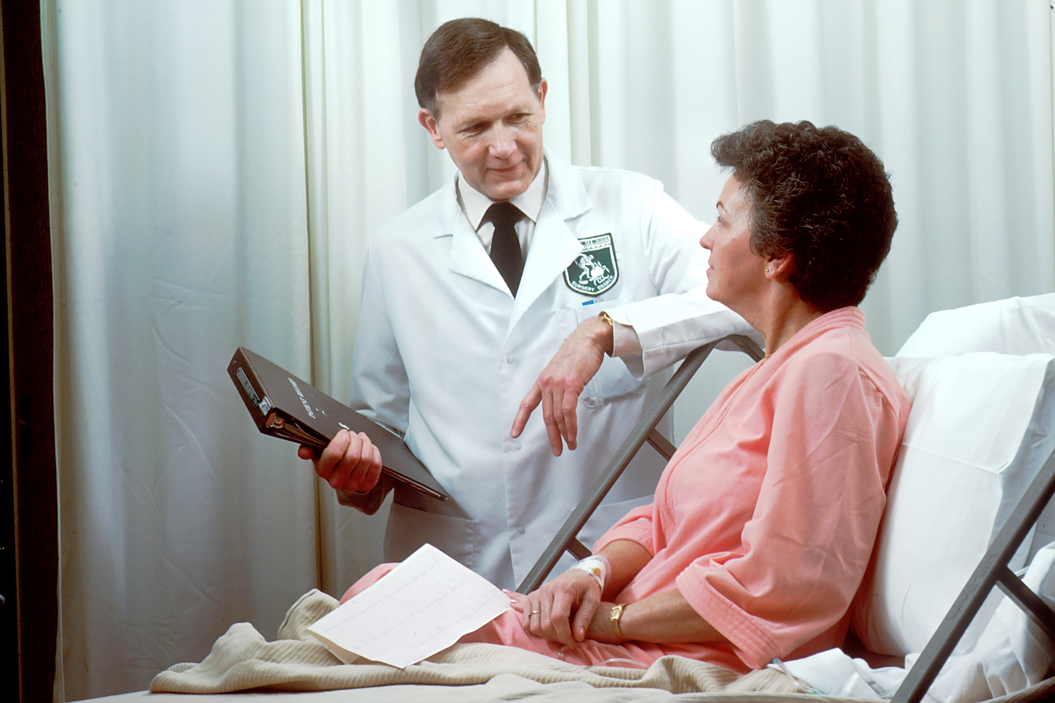
Module 2 - Cardiovascular
Let’s take a history to learn more…
Notes:
History
ROLE PLAY – INSTUCTOR and ACTOR with makeup
63 year old female
Chest tightness and pain. Radiating to neck, shoulder and arm.
Worse when exerts self. Started to occur at rest. Very severe and awoken her tonight
Associated with feeling sick, sweaty, lightheaded, short of breath. Made her want to open bowels.
Lasted for the last 1 hour
Diabetic
Smoker – 5 per day now. Trying to quit.
Overweight
Occasional alcohol
Stressful job. Middle management.
No medicines. Occasional over the counter. No allergies
Not aware of problems in the family.
Decided to get partner to driver her to AE.
What shall we do next?

Slide 5
Module 2 - Cardiovascular
Let’s examine her to learn more…
Notes:
Examination
ROLE PLAY – INSTRUCTOR and ACTOR. INSTRUCTOR describes what they are doing
End of bed description
Hands – tar staining. Pulse 105 reg.
Neck - normal
Face – pale / clammy
Chest – heart sounds – tachycardia. Hs 1+2+0
Lung sounds – tachypnoea. Normal breath sounds. Rr 22. spo2 97

Slide 6
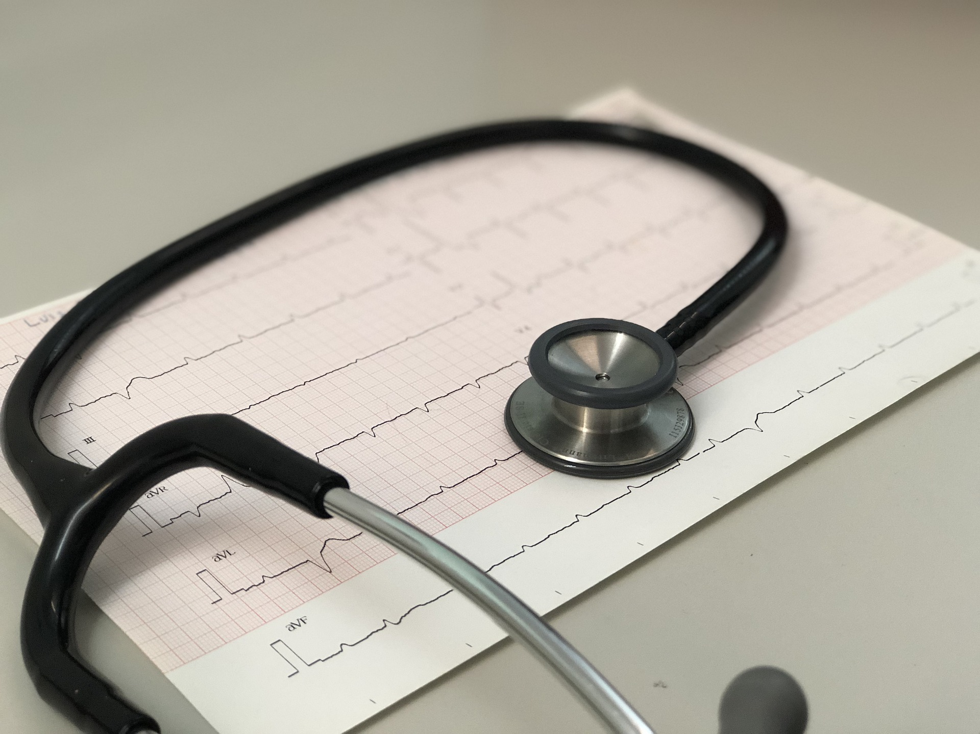
Module 2 - Cardiovascular
Lets do some investigations to learn more…
Notes:
Blood tests, ECG, CXR
ROLE PLAY – INSTRUCTOR –
APPLY OXYGEN.
GIVE LOADING DOSE OF ASPIRIN
GIVE MORPHINE
GIVE NITRATE
ASK FOR CRASH TROLLEY TO BE ON STANDBY
“I think we should put the patient on a cardiac monitor…”

Slide 7
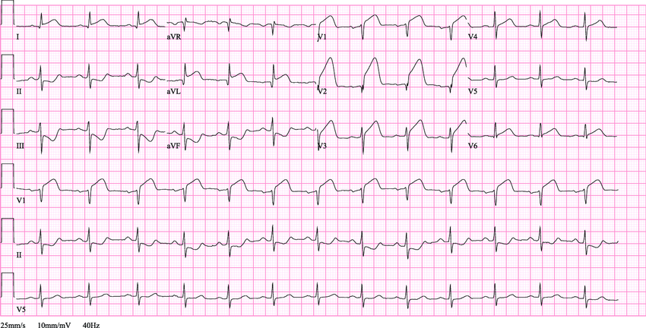
Module 2 - Cardiovascular
de Bliek, Erwin. (2018). ST elevation: Differential diagnosis and caveats. A comprehensive review to help distinguish ST elevation myocardial infarction from nonischemic etiologies of ST elevation. Turkish Journal of Emergency Medicine. 18. 10.1016/j.tjem.2018.01.008.
Notes:
Blood tests, ECG, CXR
Instructor – discuss what can be seen on this ECG – Anterior MI

Slide 8
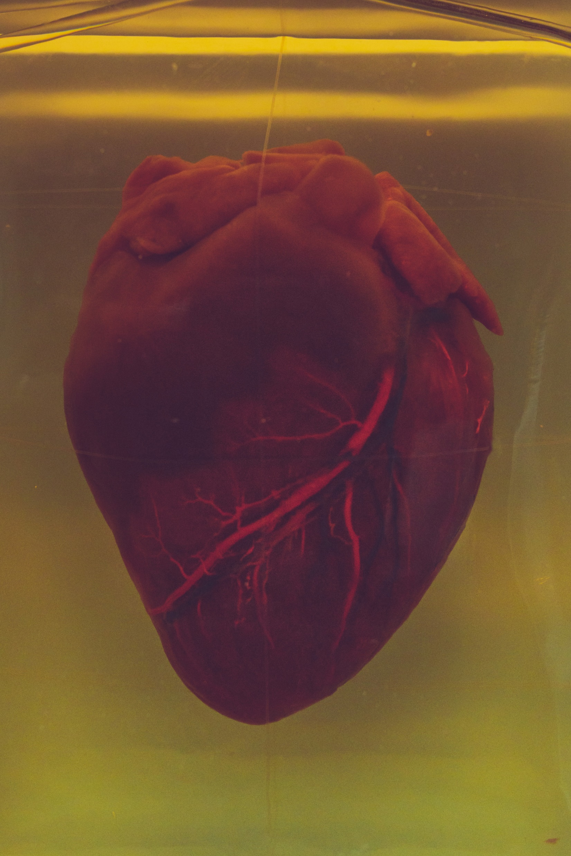
Module 2 - Cardiovascular
What’s going on inside the patient…
Notes:
Instructor – draw picture of atherosclerosis process, and eventual MI
At the end of the description, the patient needs to state
“Dr, I don’t feel well. I feel really sick and dizzy… then falls unconscious”…

Slide 9
Module 2 - Cardiovascular
Notes:
Shout for help
Already attached to ECG – shows – VT (this patient needs defib)
Video - https://www.youtube.com/watch?v=9ZTfR4AHq-c

Slide 10
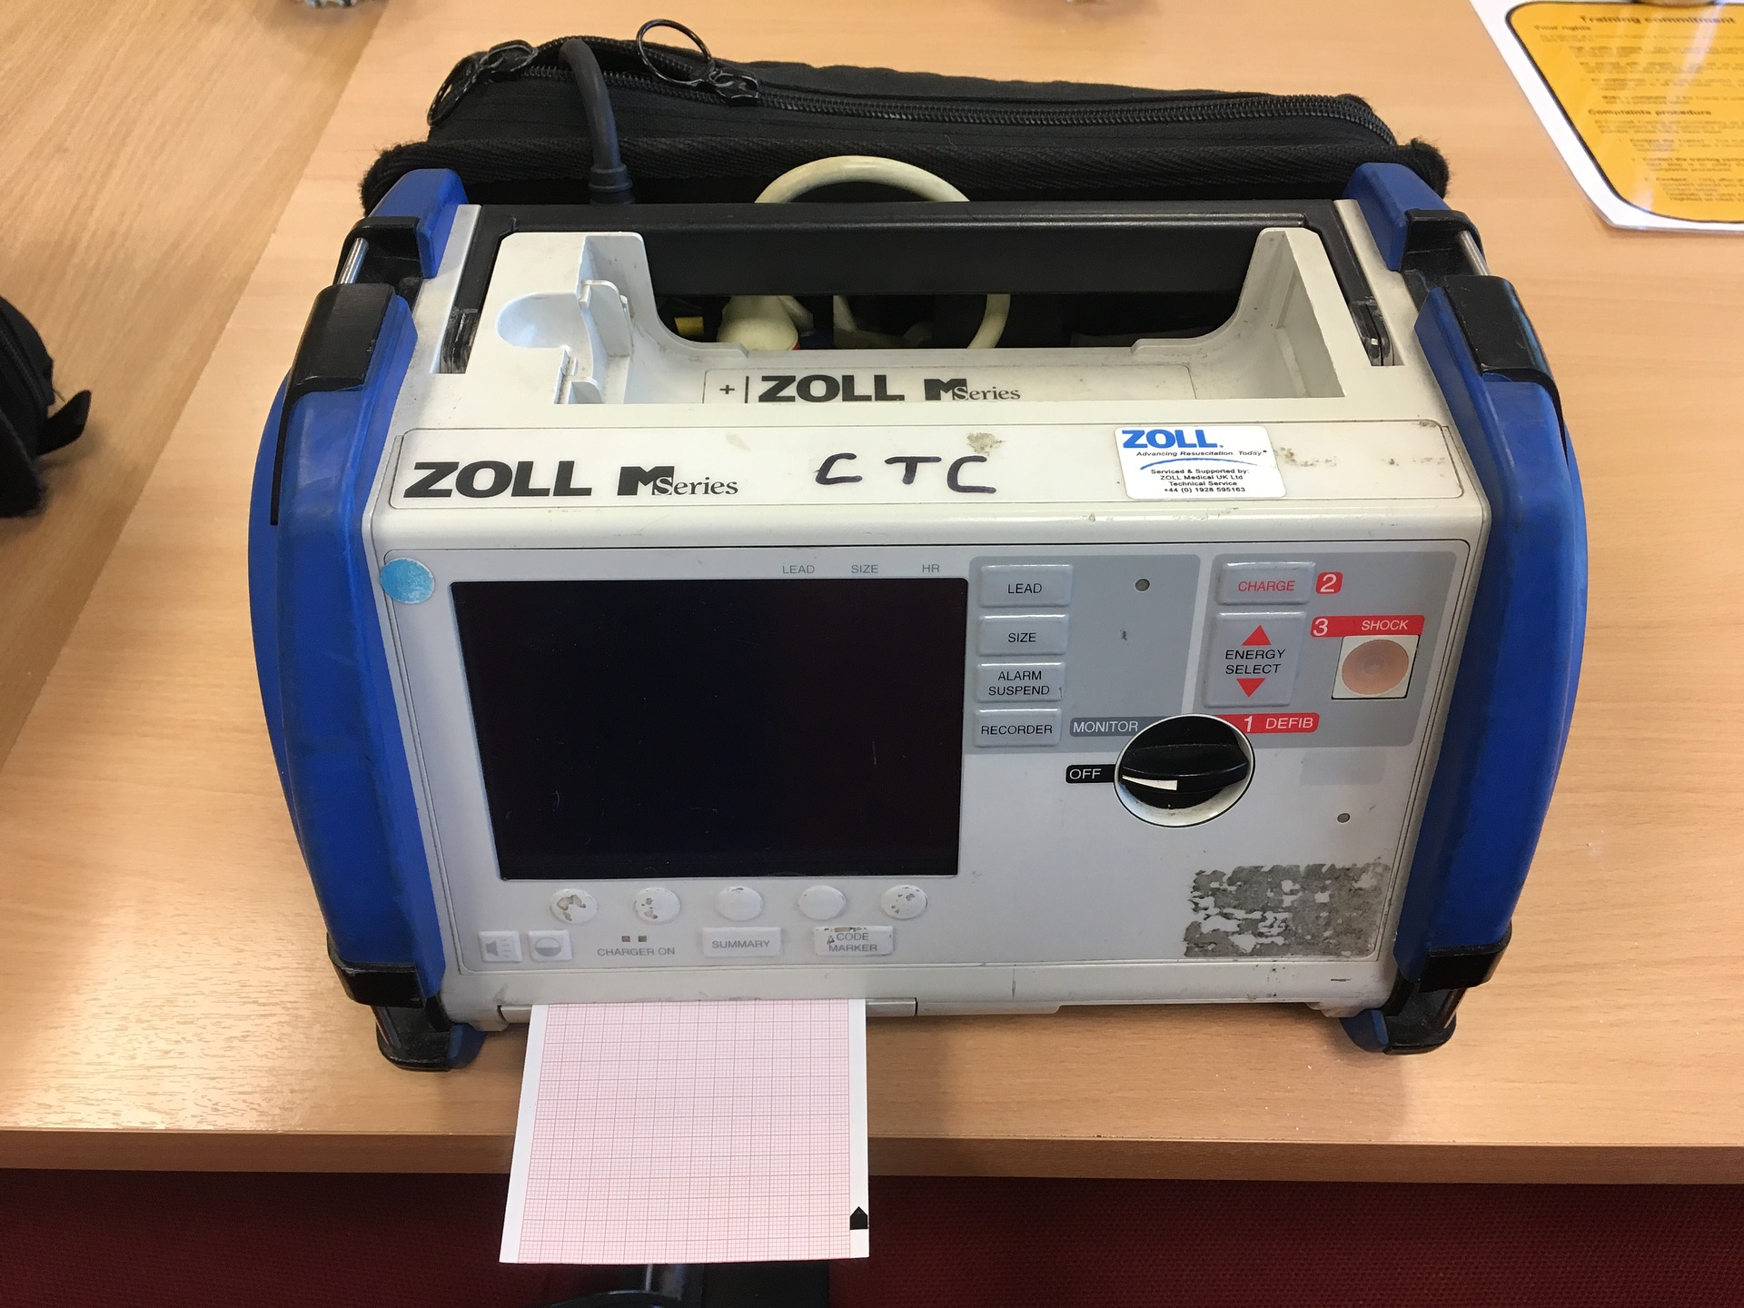
Module 2 - Cardiovascular
Notes:
Call the crash team
In hospital – dial? 2222
Grab the Defib
Remove the oxygen
Stand back
Shocking

Slide 11
Module 2 - Cardiovascular
Notes:
Already attached to ECG – shows – (sinus tachy)
Put the oxygen back on…
https://www.youtube.com/watch?v=cKXrzLrQOCc

Slide 12
Interval
Notes:
Interval
15 minute break

Slide 13
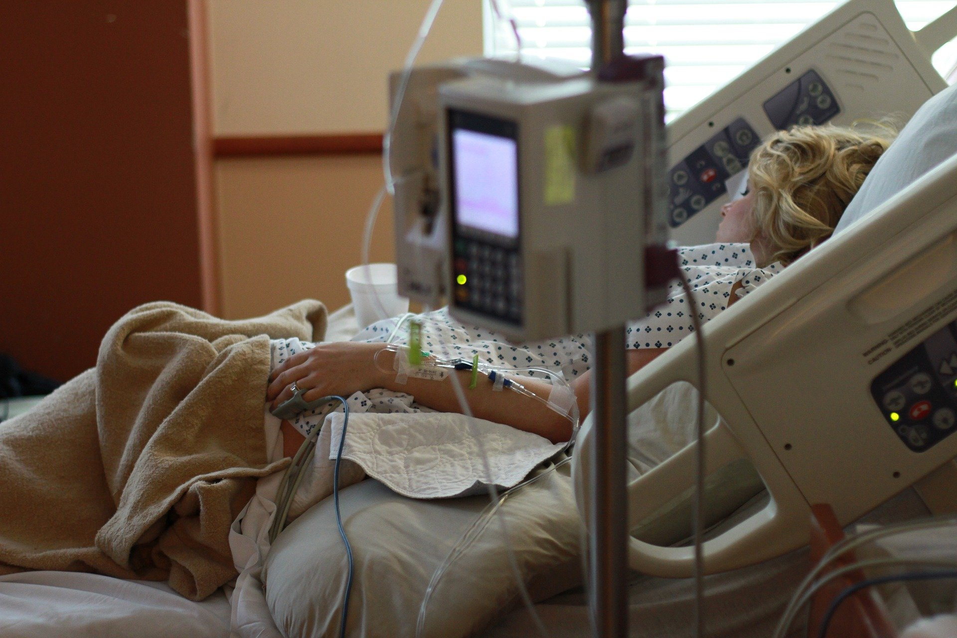
Module 2 - Cardiovascular
Let’s take stock of where we are…
Notes:
ROLE PLAY – INSTUCTOR and ACTOR with makeup
63 year old female
Chest tightness and pain. Radiating to neck, shoulder and arm.
Worse when exerts self. Started to occur at rest. Very severe and awoken her tonight
Associated with feeling sick, sweaty, lightheaded, short of breath. Made her want to open bowels.
Lasted for the last 1 hour
Diabetic
Smoker – 5 per day now. Trying to quit.
Overweight
Occasional alcohol
Stressful job. Middle management.
Attended AE and managed in resus
ECG shows STEMI
Went into VT
Output regained via defibrillation
Summary
Patient is now unconscious
Possibly in pain
Blood supply to the heart is compromised
There is a high risk of the heart entering an unusual rhythm again…
We currently have the AE team and medical resus team on hand…
What do we do next?
A – airway – do we need to contact the anaesthetic team to help secure an airway?
B – apply an oxygen mask, and give a flow to ensure spo2 high
C – ensure access. Keep SBP > 100
D – morphine to help ease pain. Dilate blood vessels. Ease strain on heart
- nitrate to dilate blood vessels
Clot – thrombolysis or pci? – Instructor – explain differences and ask team to choose.
E – check everything else working ok

Slide 14
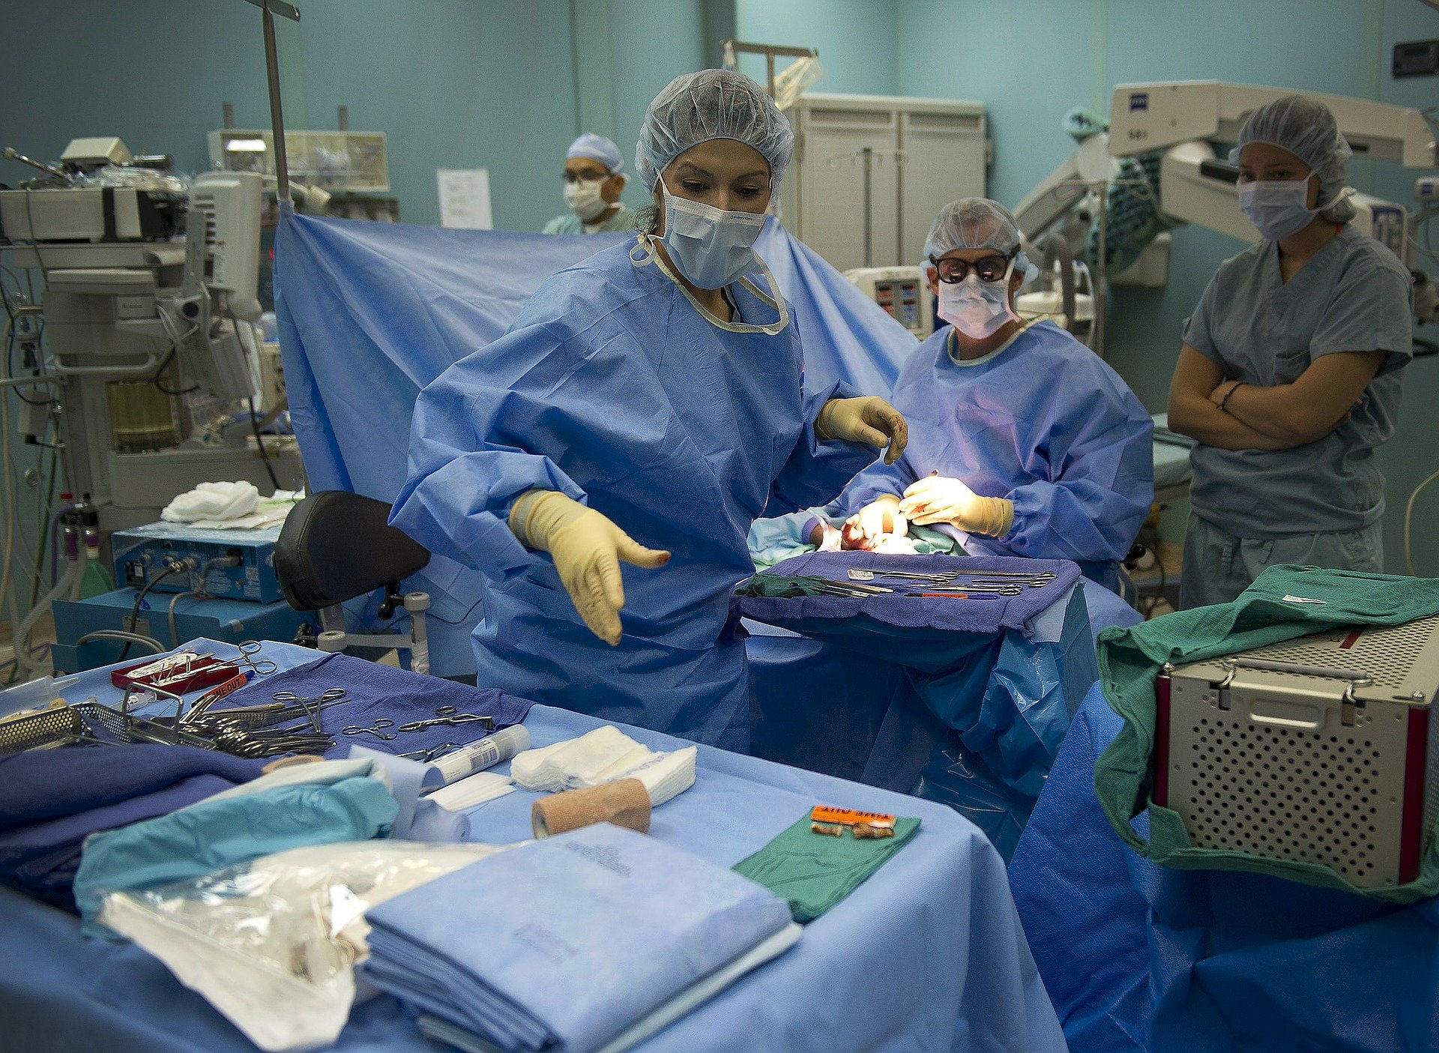
Module 2 - Cardiovascular
Let’s go to the cath lab…
Notes:
Instructor – describe what the cath lab is….
PCI to LAD stent
https://www.youtube.com/watch?v=gVMi4j6v1E4

Slide 15
Module 2 - Cardiovascular
Notes:
PCI to LAD stent
https://www.youtube.com/watch?v=gVMi4j6v1E4

Slide 16
Module 2 - Cardiovascular
Let’s take stock of where we are…
Notes:
Chronic care…
Discharged home after around 3 days.
Although recovery is likely to last around 6 months
Instructor – discuss with students - What will the patient feel like?
Tired, bruised, confused, poor short term memory, word finding difficulties, short of breath, PTSD?
Manage
- Weight
- Diabetes
Smoking
Cholesterol
Exercise
Mental health
Rehabilitation – physical and mental
Return to work?

Slide 17
Module 2 - Cardiovascular
Emergencies
Part 1 - Learning Objectives
Describe
The process of atherosclerosis
What a heart attack is
How to manage a heart attack
Demonstrate
Calmness under pressure

Slide 18
Module 2 - Cardiovascular
Emergencies
Reflection
Junior members of the medical team are usually first to attend and manage a medical emergency in a hospital. It is normal for the situation to be intense and stressful. The sounds, sights and smells can linger long in the mind after the incident has passed. What is your realistic perception of how this might affect you and your family?

