Slide 1
Pre Medical School
Mrs Neringa Smalstiene
Dr Dean Eggitt

Slide 2
Module 4 - Neurology
Brain
Toilets
Toilets are situated
Fire Safety
No fire drill is expected
The fire alarm is a continuous bell
The fire exit is situated
Safeguarding
Concerns should be reported to Mrs Neringa or Dr Dean
Please notify us immediately if you have symptoms of Covid-19

Slide 3
Module 4 - Neurology
Brain
Part 1 - Learning Objectives
Describe
The form and function of the brain
The form and function of the meninges
The blood supply of the brain
The regions of the brain and their functions
The cranial nerves

Slide 4
Module 4 - Neurology
The role of the Doctor
Notes:
Neurology
Medical speciality
9 years
Neurosurgeon
Surgical speciality
10 years
Both very competitive
Usually requires a period of research

Slide 5
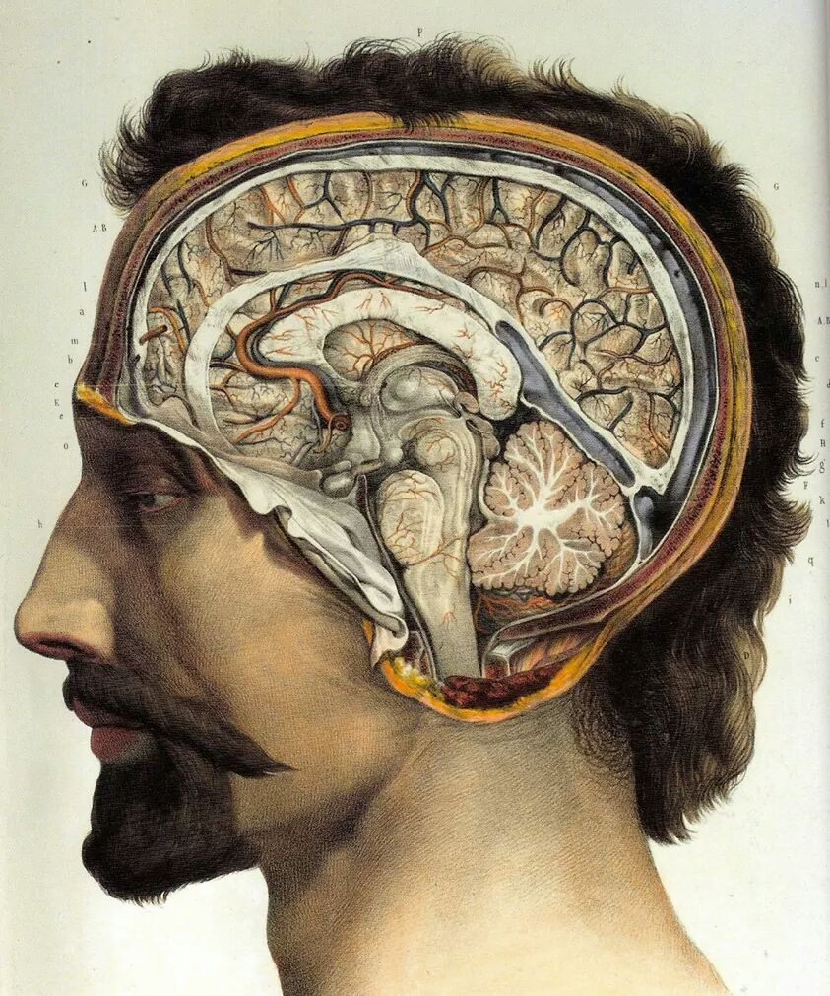
Module 4 - Neurology
By Erald Mecani - Own work, CC BY-SA 3.0, https://commons.wikimedia.org/w/index.php?curid=35272026
Notes:
What is the brain?
Collection of nerves, glial cells and blood vessels
Nerves - send electric signals
Glial cells – supportive connecting cells that provide protection and nutrition to the nerves
Brain is plastic. Lots of spare unused nerves at birth, waiting to be assigned a function.
Reads, writes, and re-writes through life.
Nerves change connections depending upon frequency of that connection used – if a connection is used a lot – it becomes “strong”. If unused, it is re-assigned.
Can eventually runs out of functional nerves to be able to write new features

Slide 6
Module 4 - Neurology
By https://www.scientificanimations.com
https://www.scientificanimations.com/wiki-images
Notes:
Meninges
D - dura
A - arachnoid
P – pia
Functions
- Encapsulate Cerebrospinal fluid
- trauma defence
- Support vessels

Slide 7
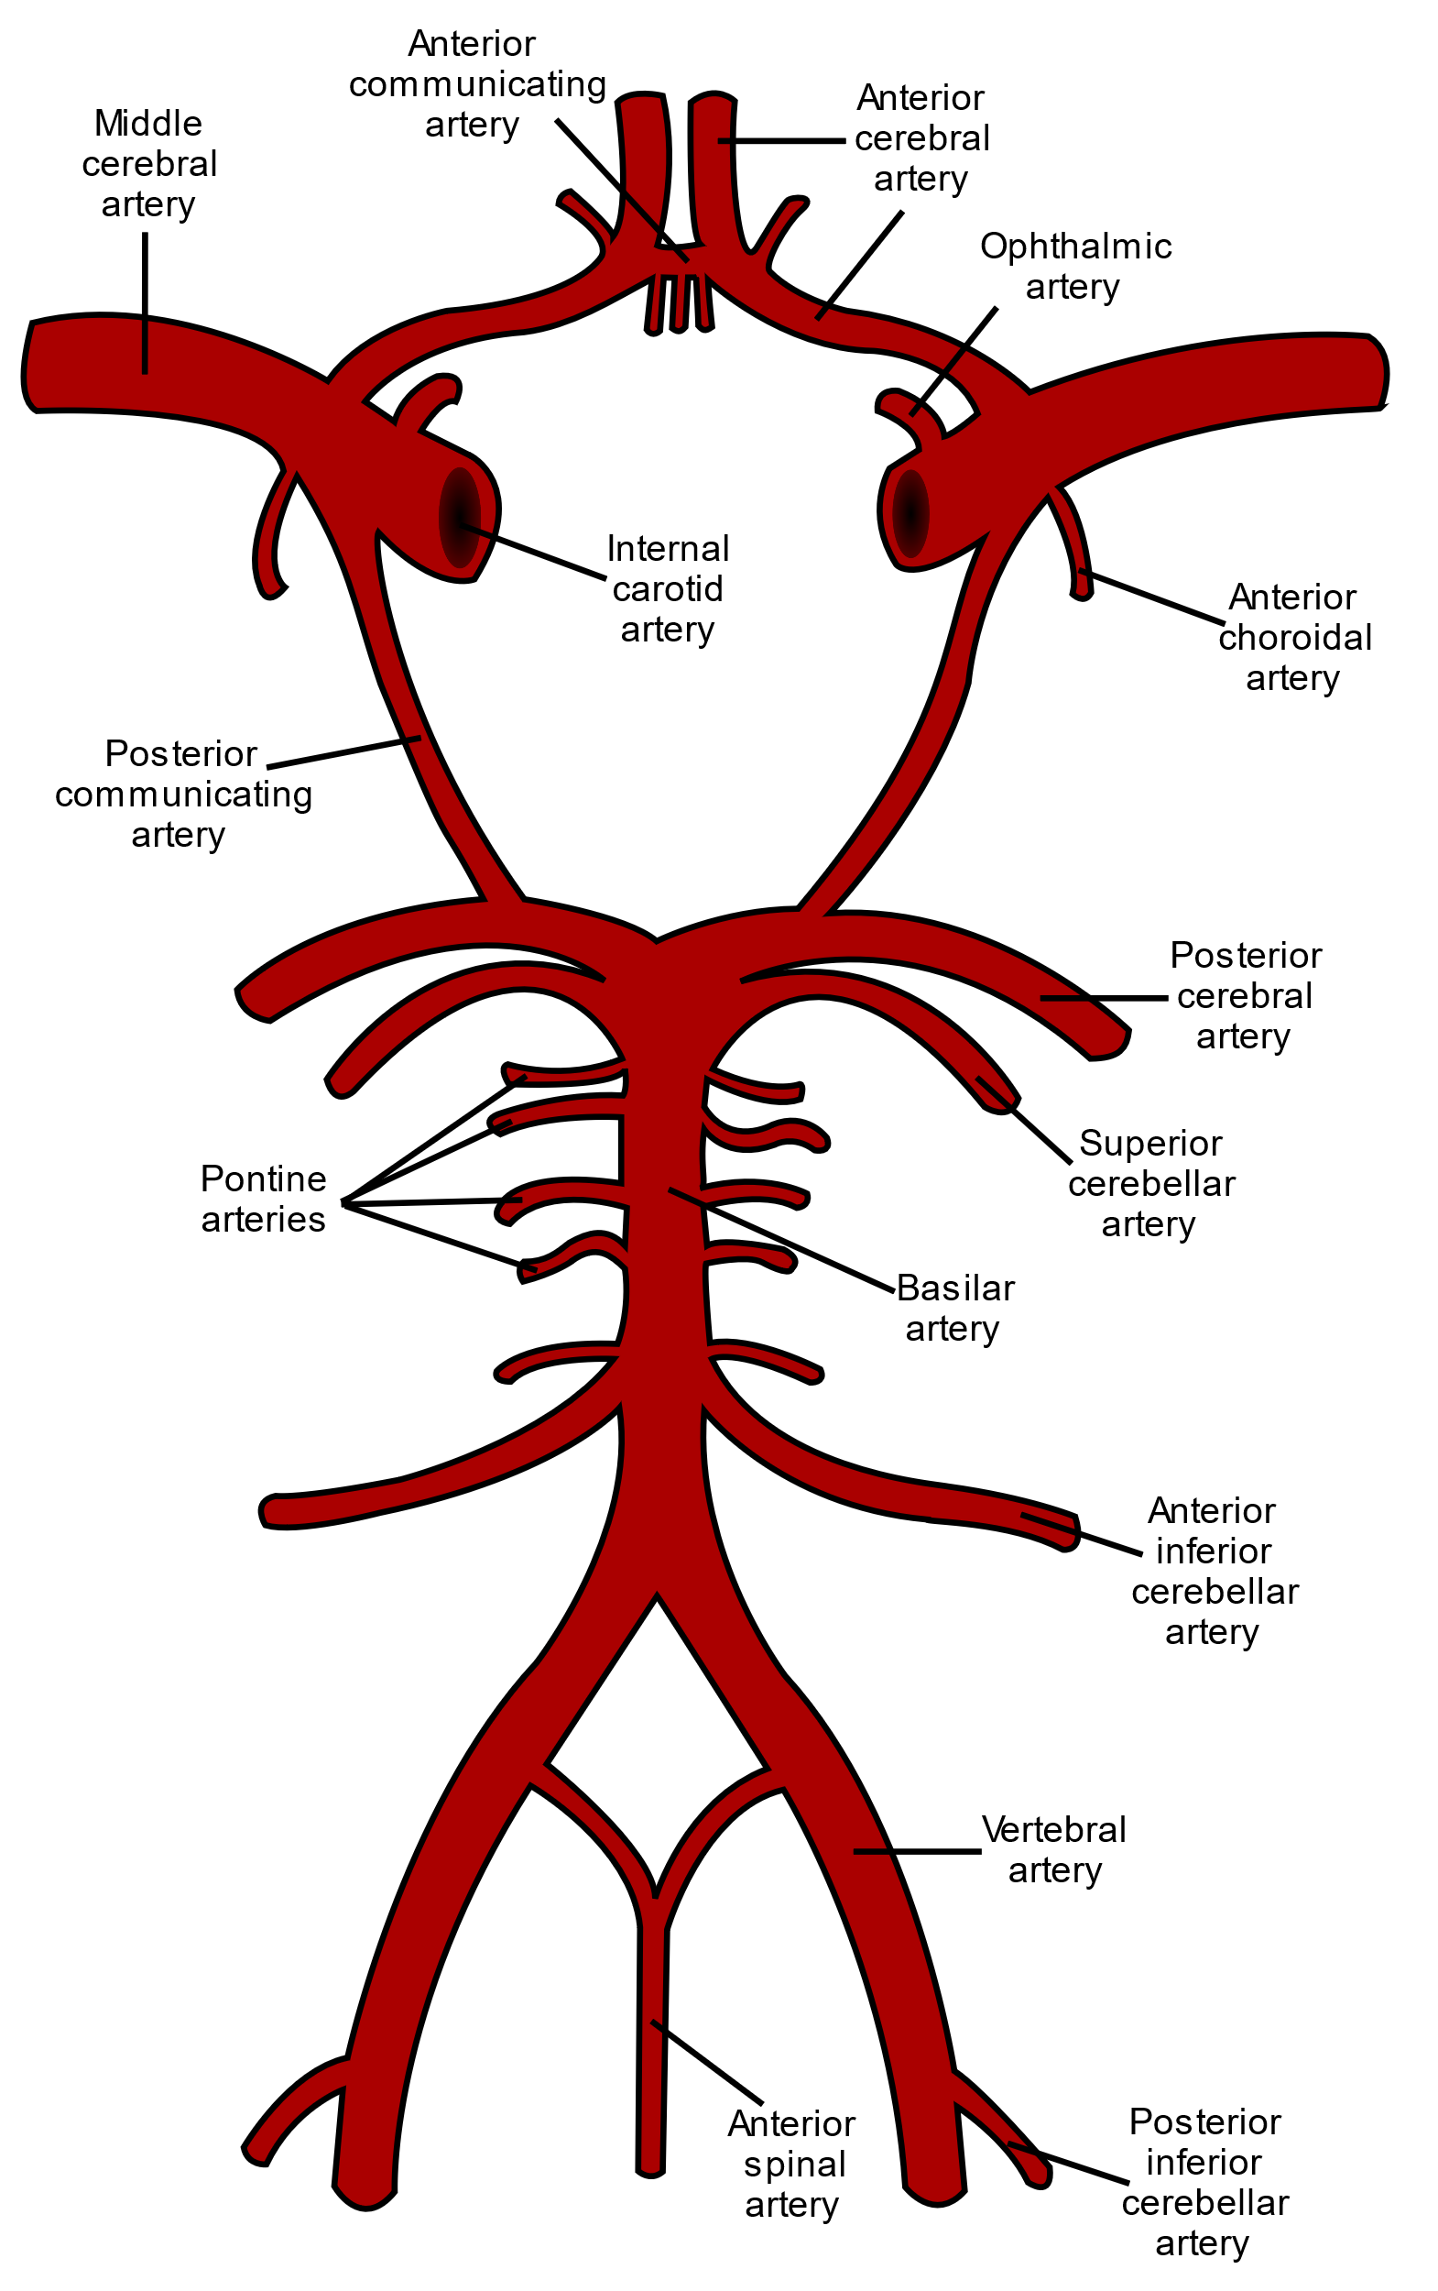
Notes:
Circle of Willis
Useful collection of arteries that allows redundant circulation in the brain
If one part is disconnected, the other parts should be able to supply
Anterior, and posterior circulations
Middle artery is NOT a part of the CIRCLE of willis

Slide 8
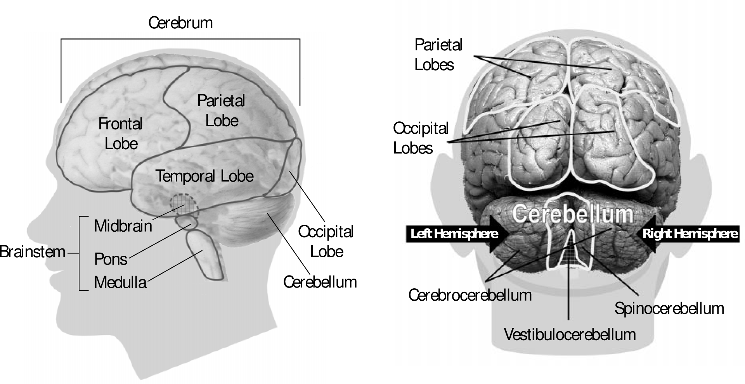
Module 4 - Neurology
Brain
Notes:
Frontal – personality / speech
Parietal – sensory / language
Temporal – memory / sensory / language
Occipital – visual
Hypothalamus – homeostasis
Pituitary – coordination of hormone communication
Cerebellum – coordination of movement

Slide 9
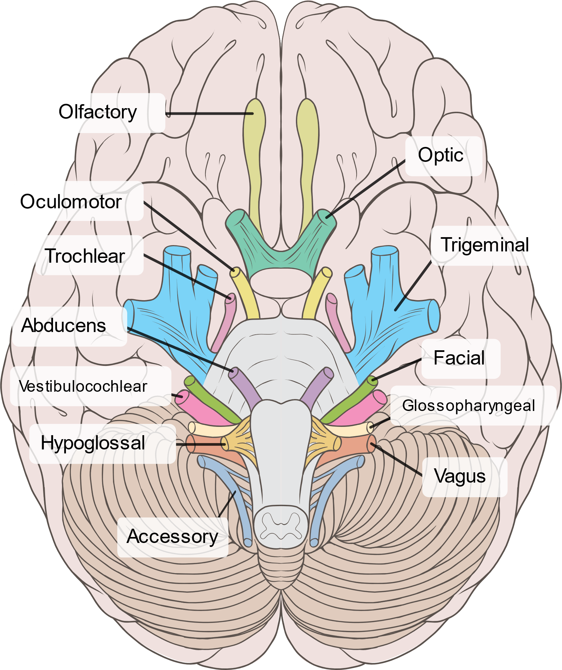
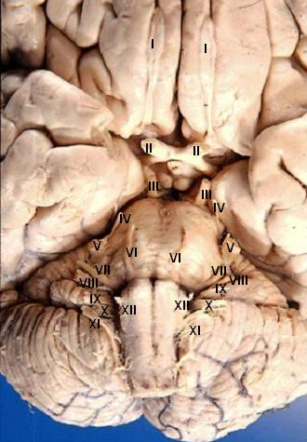
By John A Beal, PhDDep&#039;t. of Cellular Biology &amp; Anatomy, Louisiana State University Health Sciences Center Shreveport - http://www.healcentral.org/healapp/showMetadata?metadataId=40566 (Internet Archive of file description page), CC BY 2.5, https://commons.wikimedia.org/w/index.php?curid=891480
By Brain_human_normal_inferior_view_with_labels_en.svg: *Brain_human_normal_inferior_view.svg: Patrick J. Lynch, medical illustratorderivative work: Beaoderivative work: Dwstultz (talk) - Brain_human_normal_inferior_view_with_labels_en.svg, CC BY 2.5, https://commons.wikimedia.org/w/index.php?curid=15108118
Notes:
1 – olfactory – smell
2 – optic – vision
3 – oculomotor – moves eyes. Constrict pupils. Moves upper eyelid.
4 – trochlear – move eyes
5 – trigeminal – sensation of face / cornea. Muscles used when eating
6 – abducens – move eyes
7 – facial – facial movement. Some taste. Tear and salivary glands.
8 – vestibulocochlear – hearing and balance
9 – glossopharyngeal – sensation in mouth. Salivary glands
10 – vagus – autonomic function. Sensation of larynx / pharynx. Vocal cords. Swallowing
11 – accessory – neck and shoulder muscles
12 – hypoglossal – movements of tongue

Slide 10
Interval
Notes:
Interval
15 minute break

Slide 11
Module 4 - Neurology
Brain
Part 2 - Learning Objectives
Demonstrate
How to examine cranial nerves II, III, IV, V, VI
Notes:
2 - optic
3 - oculomotor
4 - trochlear
5 - trigeminal
6 – abducens
Visual acuity
Snellen chart (don’t do this – just explain existence)
Visual fields (do this)
Accommodation to distance
Accommodation to light
- Direct constriction and relaxation of pupil
Indirect constriction and relaxation of pupils
Movement of eyes
Nystagmus
Diplopia
Facial sensation
- Temporal branch
Maxillary branch
Mandibular branch
Muscles of mastication
Clench jaw
Open mouth

Slide 12
Module 4 - Neurology
Brain
Reflection
Damage to the brain can seriously impact the ability to carry out activities of daily living, causing the need for adaptions and support to perform simple tasks. Can you see from the perspective of others and describe how you might imagine life after a disabling stroke?

